Slide 1

Exploratory Data Analysis
By
JIten Sahoo
Git hub link : https://github.com/jitensahoo/Datascience_training

Slide 2
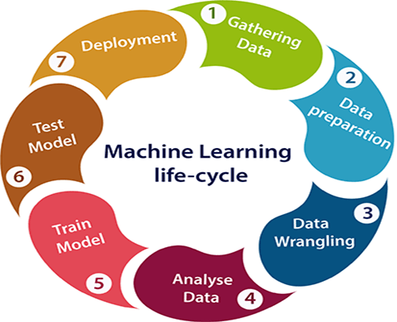
Machine Learning Life Cycle

Slide 3

What is EDA
Exploratory Data Analysis
It is an approach to analyze the data using visual techniques. It is used to discover trends, patterns, or to check assumptions with the help of statistical summary and graphical representations.

Slide 4
Read a dataset.
Pd.read_csv()
Pd.read_excel()
Pd.read_html()
Pd.read_sql()

Slide 5

Basic checking
Df.head()
Df.info()
Df.shape
Df.describe()

Slide 6

Checking missing values
What is missing values?
How it is represented?
Why Is Data Missing From The Dataset ?
Types Of Missing Value

Slide 7

Types Of Missing Value
Missing
Missing Completely At Random (MCAR)
Missing
Missing At Random (MAR)
Missing
Missing Not At Random (MNAR)

Slide 8

MCAR
In MCAR, the probability of data being missing is the same for all the observations.
In this case, there is no relationship between the missing data and any other values observed or unobserved (the data which is not recorded) within the given dataset.
Missing values are completely independent of other data. There is no pattern.
In the case of MCAR, the data could be missing due to human error, some system/equipment failure, loss of sample, or some unsatisfactory technicalities while recording the values.
The advantage of such data is that the statistical analysis remains unbiased.

Slide 9
MAR
Missing at random (MAR) means that the reason for missing values can be explained by variables on which you have complete information as there is some relationship between the missing data and other values/data.
In this case, the data is not missing for all the observations. It is missing only within sub-samples of the data and there is some pattern in the missing values.
For example, if you check the survey data, you may find that all the people have answered their ‘Gender’ but ‘Age’ values are mostly missing for people who have answered their ‘Gender’ as ‘female’. (The reason being most of the females don’t want to reveal their age.)
In this case, the statistical analysis might result in bias.

Slide 10
MNAR
Missing values depend on the unobserved data.
If there is some structure/pattern in missing data and other observed data can not explain it, then it is Missing Not At Random (MNAR).
If the missing data does not fall under the MCAR or MAR then it can be categorized as MNAR.
It can happen due to the reluctance of people in providing the required information. A specific group of people may not answer some questions in a survey.
For example, suppose the name and the number of overdue books are asked in the poll for a library. So most of the people having no overdue books are likely to answer the poll. People having more overdue books are less likely to answer the poll.

Slide 11
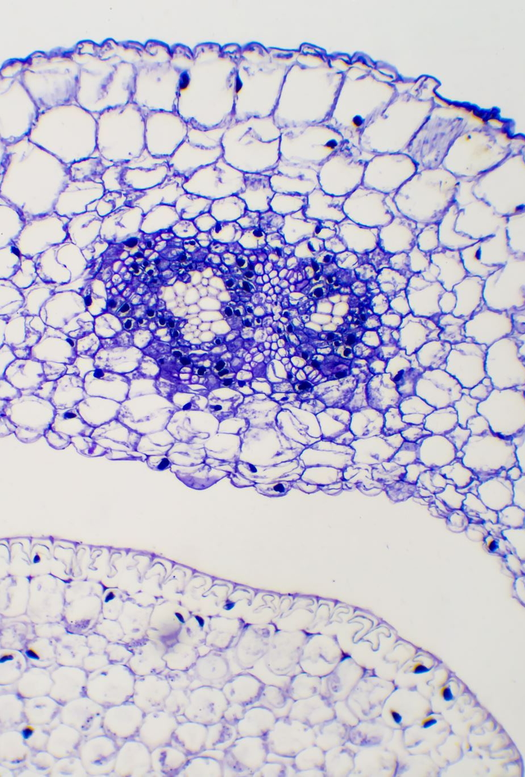
Detecting NaN value
Df.isnull()
Df.isna()
Df.isna().sum()

Slide 12

Handling Missing values
Deleting
df.dropna(axis=1,inplace=True)
2. Imputing value

Slide 13

Impute value
Replace with mean
Replace with median
Replace with mode
Replace with other value
Fill with pad
Replace using bfill(backfill)
Replace with ffill(forwardfill)
Interpolation (df.interpolate())

Slide 14
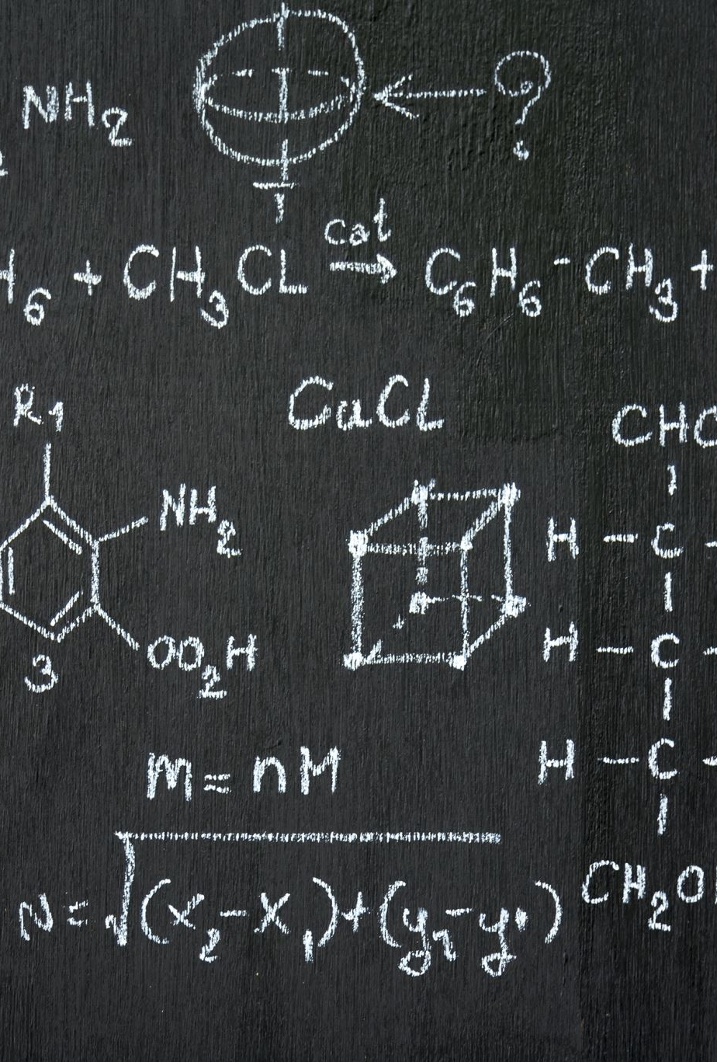
Impute Categorical value
Using simple imputer
from sklearn.impute import SimpleImputer imputer = SimpleImputer(strategy='most_frequent') imputer.fit_transform(X)

Slide 15
Impute using KNNimputer
from sklearn.impute import KNNImputer impute_knn = KNNImputer(n_neighbors=5) impute_knn.fit_transform(X)
Ref : https://scikit-learn.org/stable/modules/generated/sklearn.impute.KNNImputer.html

Slide 16
Replace a value
df.replace(-99,0,inplace=True)

Slide 17
Use a model to impute
Use any algorithm to impute the value.

Slide 18
Questions
Create dataset or fetch dataset (tips) from seaborn library
Set some column values as nan
Set the values for tip to 0 for which total_bill is less than 20 .
Create a new column as gender for which represent the sex column values is equal to 'Male' as 'M' and 'Female' as 'F'.
Transform the column value day from 'Sun' to 'Sunday' .

Slide 19

Outlier
An outlier is an individual point of data that is distant from other points in the dataset. It is an anomaly in the dataset that may be caused by a range of errors in capturing, processing or manipulating data. Outliers can skew overall data trends, so outlier detection methods are an important part of statistics. Outliers will be a consideration for any area that uses data to make decisions. If an organisation is gaining insight from data, outliers are a real risk.
The three main types of outliers are:
Point outliers
Contextual outliers
Collective outliers

Slide 20
Common causes of outliers in machine learning include
Human error when entering or labelling data.
Errors in measuring or collecting the data.
Errors in data extraction, processing or manipulation.
Man-made outliers for testing outlier detection processes.
Natural occurrences of outliers that aren’t errors, which can be called dataset novelties.

Slide 21

outlier detection methods
Boxplot
Use your own value or range to detect outlier
3. Z-score technique ( when data is Normally distributed)
4. IQR ( when skewed data)
5. Scatter plot
6. Distance from the mean method (Multivariate method)
this method considers multiple variables in a data set to detect outliers. This method calculates the Euclidean distance of the data points from their mean and converts the distances into absolute z-scores. Any z-score greater than the pre-specified cut-off (mostly 3)is considered to be an outlier.

Slide 22

How to handle Outlier
Trimming/removing the outlier
Quantile based flooring and capping (replace with 90th percentile or 10th percetile value)
Mean/Median imputation
Use Robust scalar (value = (value – median) / (p75 – p25) )

Slide 23
Robust scalar
Robust scalar
(value = (value – median) / (p75 – p25) )
1.removes the median from the data.
2.scales the data by the InterQuartile Range(IQR)

Slide 24
Example of Outlier
Credit card fraud detection
High body Temprature

Slide 25

Univariate and Bivariate plot
lineplot
Scatter PLot
Regplot
Dist plot
Hist plot
Heatmap

Slide 26

Need of Column Standardization
Standardization is the process of creating protocols to guide the creation of a good or service based on the consensus of all the relevant parties in the industry.
Used to standardise the data.

Slide 27
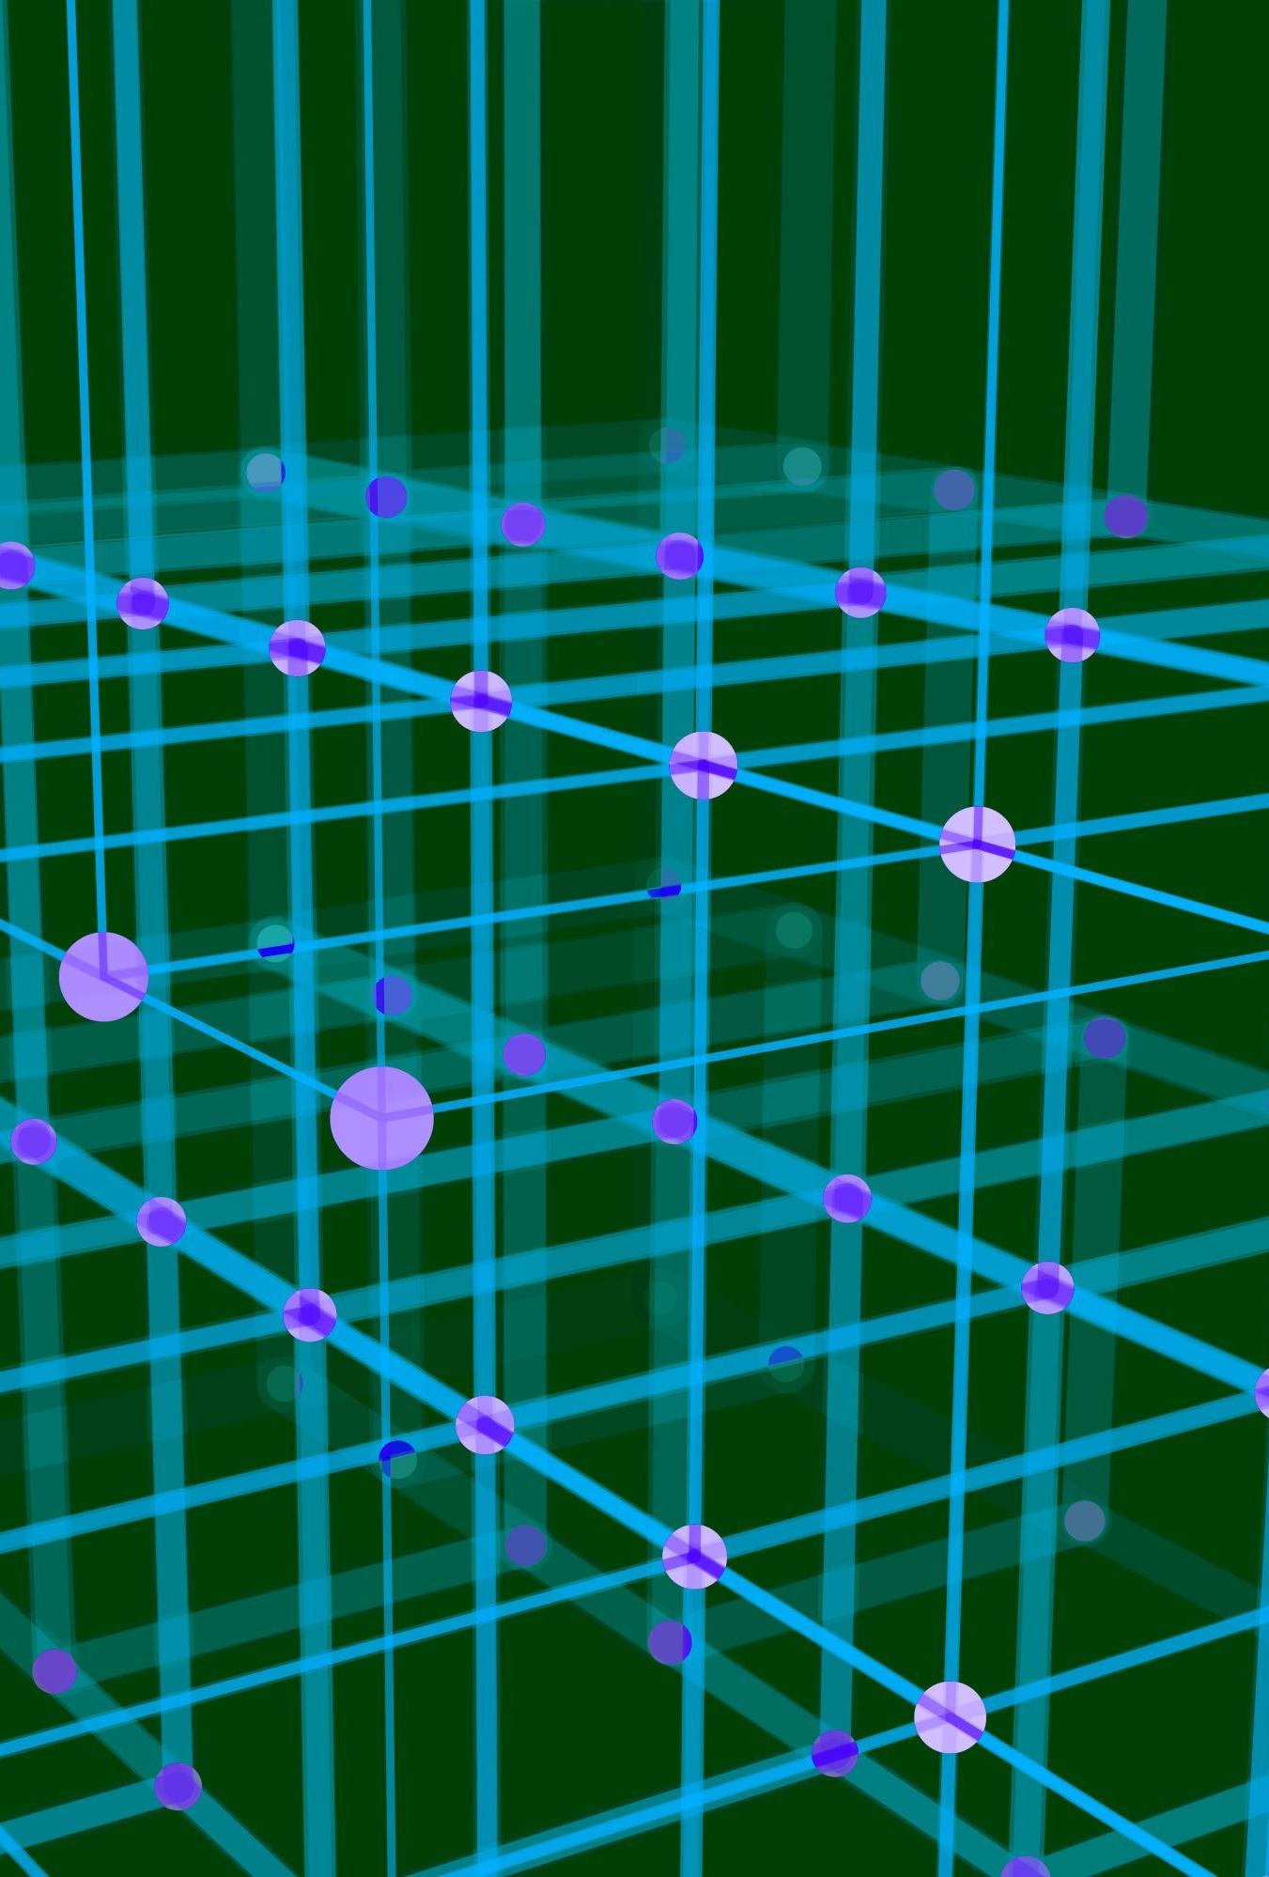
Standardization
The process of transforming the value to mean as 0 and std deviation as 1.
It forms a bell curve.

Slide 28

Normalization
Transform the value to a specific range .e.g 0-10

Slide 29
Log transformation
The Log Transform is one of the most popular Transformation techniques out there. It is primarily used to convert a skewed distribution to a normal distribution/less-skewed distribution.

Slide 30
Square root transformation

Slide 31

Treating categorical values
Categorical data is a type of data that is used to group information with similar characteristics, while numerical data is a type of data that expresses information in the form of numbers.
Example of categorical data: gender

Slide 32

Why do we need encoding?
Most machine learning algorithms cannot handle categorical variables unless we convert them to numerical values
Many algorithm’s performances even vary based upon how the categorical variables are encoded

Slide 33
Categorical variables can be divided into two categories
Nominal: The nominal data called labelled/named data. Allowed to change the order of categories, change in order doesn’t affect its value. For example, Gender (Male/Female/Other), Age Groups (Young/Adult/Old), etc.
Ordinal Data: Represent discretely and ordered units. It is same as nominal data but have ordered/rank. Not allowed to change the order of categories. For example, Ranks: 1st/2nd/3rd, Education: (High School/Undergrads/Postgrads/Doctorate), etc.

Slide 34

Types of Encoding techniques
One-hot Encoding
Label Encoding
Ordinal Encoding
Helmert Encoding
Binary Encoding
Frequency Encoding
Mean Encoding (used for Pincode)
Weight of Evidence Encoding
Probability Ratio Encoding
Hashing Encoding
Backward Difference Encoding
Leave One Out Encoding
James-Stein Encoding
M-estimator Encoding
Thermometer Encoder
Reference : https://towardsdatascience.com/ways-to-handle-categorical-data-before-train-ml-models-with-implementation-ffc213dc84ec

Slide 35

Using Get_dummies
Pd.get_dummies()

Slide 36
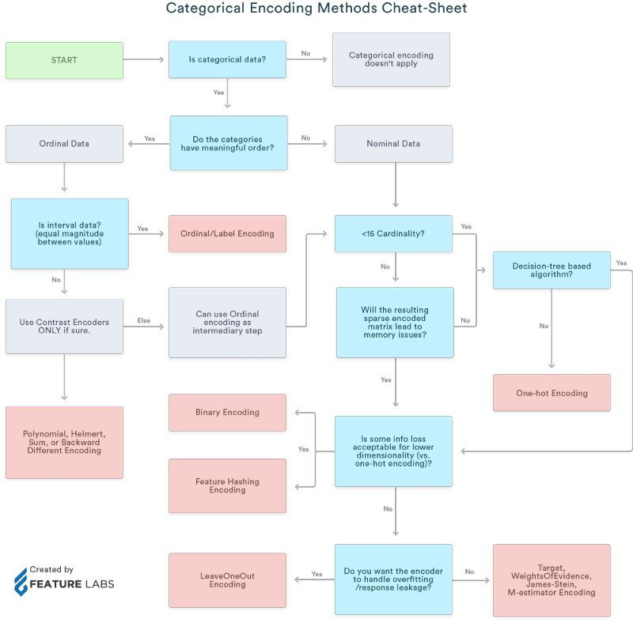

Slide 37
Feature Importance

